Slide 1

Chapter 11
Message Integrity
and
Message Authentication
Copyright © The McGraw-Hill Companies, Inc. Permission required for reproduction or display.
11.<number>

Slide 2
Message Authentication
message authentication is concerned with:
  protecting the integrity of a message
  validating identity of originator
  non-repudiation of origin (dispute resolution)
will consider the security requirements
then three alternative functions used:
  message encryption
  message authentication code (MAC)
  hash function
Notes:
Up till now, have been concerned with protecting message content (ie secrecy) by encrypting the message. Will now consider how to protect message integrity (ie protection from modification), as well as confirming the identity of the sender. Generically this is the problem of message authentication, and in eCommerce applications is arguably more important than secrecy.

Slide 3
Security Requirements
disclosure
traffic analysis
masquerade
content modification
sequence modification
timing modification
source repudiation
destination repudiation
Notes:
The first two requirements belong in the realm of message confidentiality, and are handled using the encryption techniques already discussed.
The remaining requirements belong in the realm of message authentication. At its core this addresses the issue of ensuring that a message comes from the alleged source and has not been altered. It may also address sequencing and timeliness. The use of a digital signature can also address issues of repudiation.

Slide 4
Message Encryption
message encryption by itself also provides a measure of authentication
if symmetric encryption is used then:
  receiver know sender must have created it
  since only sender and receiver now key used
  know content cannot of been altered
  if message has suitable structure, redundancy or a checksum to detect any changes

Slide 5
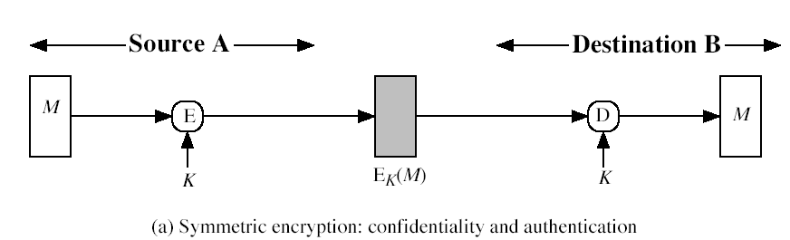
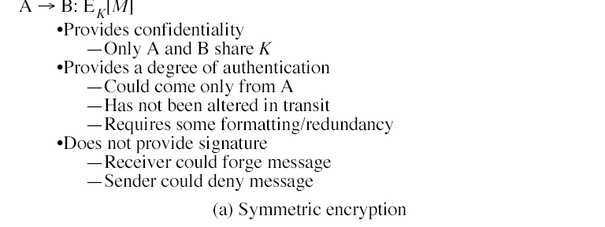

Slide 6
Digital Signatures
have looked at message authentication
  but does not address issues of lack of trust
digital signatures provide the ability to:
  verify author, date & time of signature
  authenticate message contents
  be verified by third parties to resolve disputes
hence include authentication function with additional capabilities

Slide 7
Digital Signature Properties
must depend on the message signed
must use information unique to sender
  to prevent both forgery and denial
must be relatively easy to produce
must be relatively easy to recognize & verify
be computationally infeasible to forge
  with new message for existing digital signature
  with fraudulent digital signature for given message
be practical save digital signature in storage

Slide 8
Message Encryption
if public-key encryption is used:
  encryption provides no confidence of sender
  since anyone potentially knows public-key
  however if
    sender signs message using their private-key
    then encrypts with recipients public key
    have both secrecy and authentication
  again need to recognize corrupted messages
  but at cost of two public-key uses on message

Slide 9
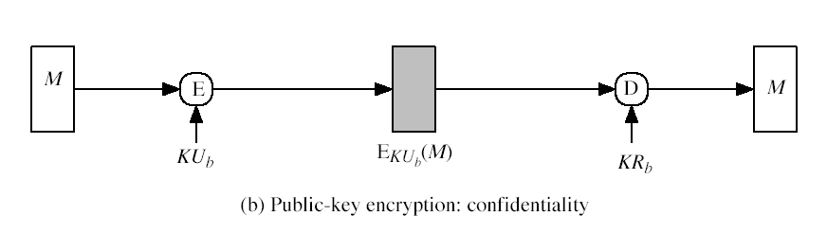
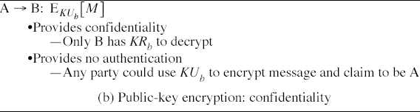

Slide 10
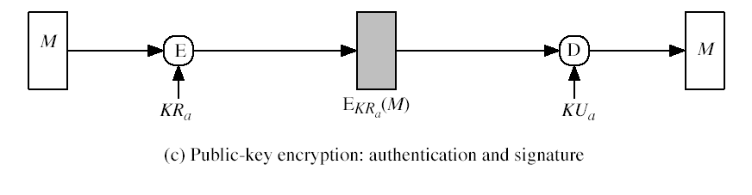
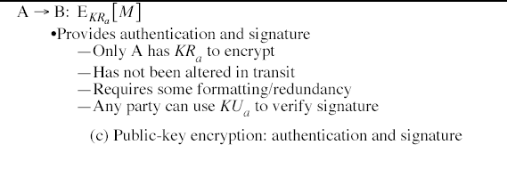

Slide 11
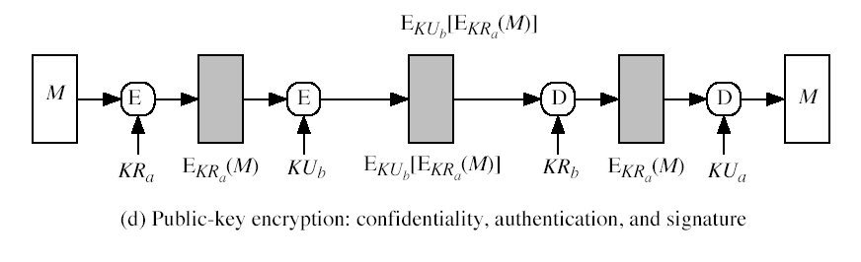
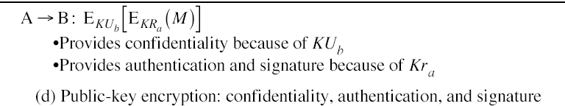

Slide 12
Message Authentication Code (MAC)
generated by an algorithm that creates a small fixed-sized block
  depending on both message and some key
  like encryption though need not be reversible
appended to message as a signature
receiver performs same computation on message and checks it matches the MAC
provides assurance that message is unaltered and comes from sender

Slide 13
Message Authentication Codes
as shown the MAC provides confidentiality
can also use encryption for secrecy
  generally use separate keys for each
  can compute MAC either before or after encryption
  is generally regarded as better done before
why use a MAC?
  sometimes only authentication is needed
  sometimes need authentication to persist longer than the encryption (eg. archival use)
note that a MAC is not a digital signature

Slide 14
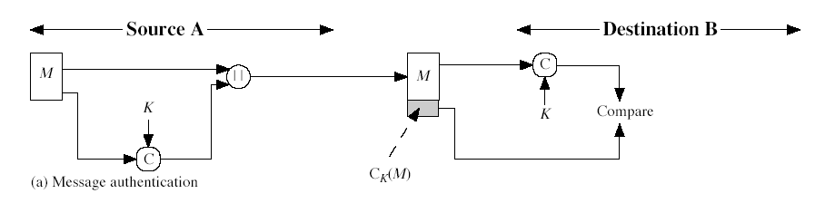
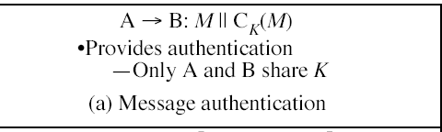

Slide 15
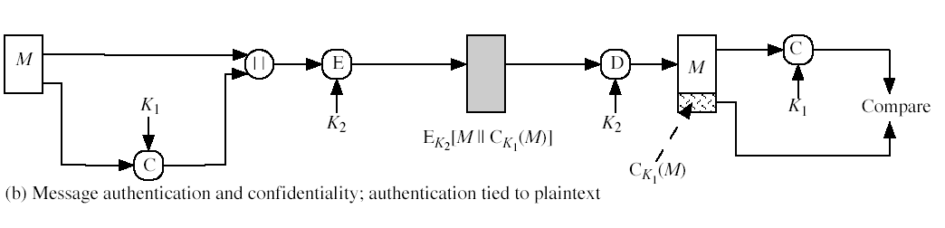
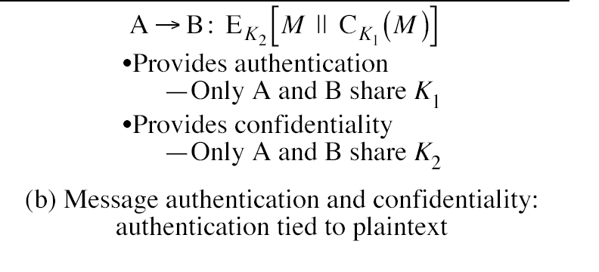

Slide 16
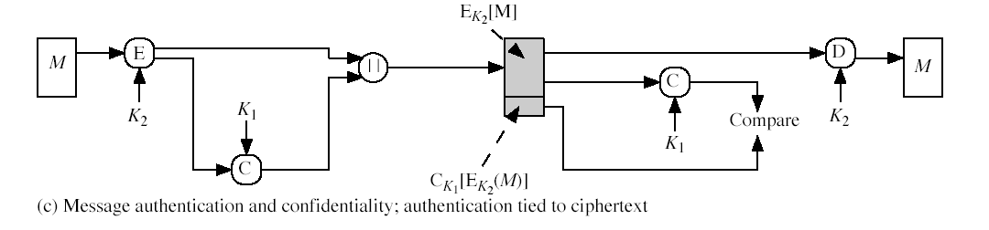
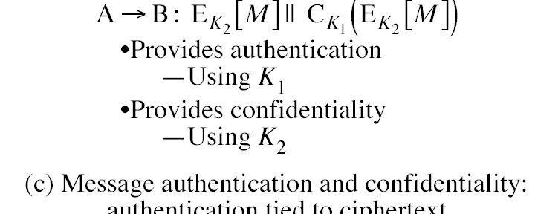

Slide 17
MAC Properties
a MAC is a cryptographic checksum
  MAC = C_{K}(M)
  condenses a variable-length message M
  using a secret key K
  to a fixed-sized authenticator
is a many-to-one function
  potentially many messages have same MAC
  but finding these needs to be very difficult

Slide 18
Requirements for MACs
taking into account the types of attacks
need the MAC to satisfy the following:
  knowing a message and MAC, is infeasible to find another message with same MAC
  MACs should be uniformly distributed
  MAC should depend equally on all bits of the message

Slide 19
Using Symmetric Ciphers for MACs
can use any block cipher chaining mode and use final block as a MAC
Data Authentication Algorithm (DAA) is a widely used MAC based on DES-CBC
  using IV=0 and zero-pad of final block
  encrypt message using DES in CBC mode
  and send just the final block as the MAC
    or the leftmost M bits (16≤M≤64) of final block
but final MAC is now too small for security
Notes:
Can also use block cipher chaining modes to create a separate authenticator, by just sending the last block. However this suffers from being a bit too small for acceptable use today.

Slide 20
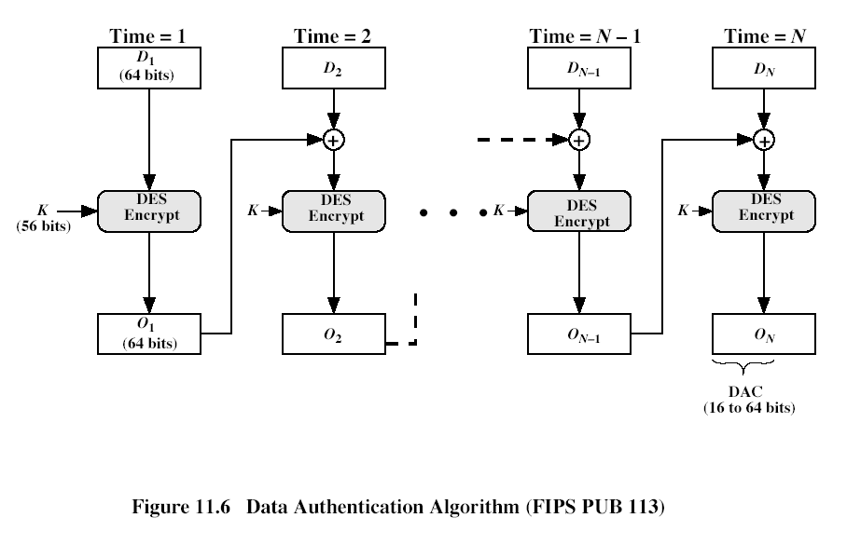

Slide 21
Hash Functions
condenses arbitrary message to fixed size
usually assume that the hash function is public and not keyed
  cf. MAC which is keyed
hash used to detect changes to message
can use in various ways with message
most often to create a digital signature

Slide 22
Hash Function Properties
a Hash Function produces a fingerprint of some file/message/data
  h = H(M)
  condenses a variable-length message M
  to a fixed-sized fingerprint
assumed to be public

Slide 23
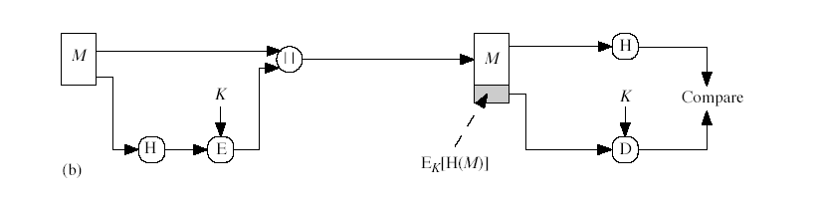
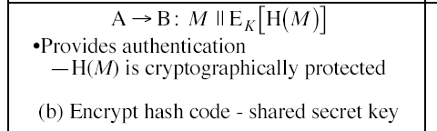

Slide 24
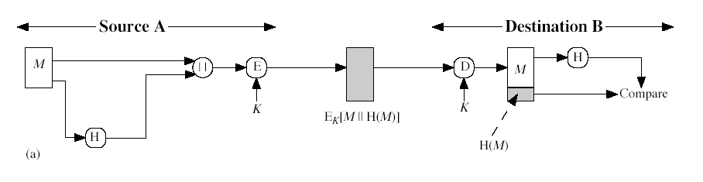
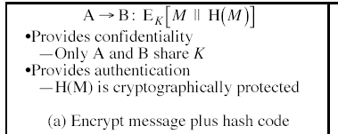

Slide 25
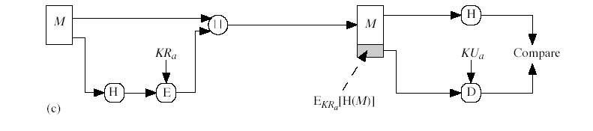
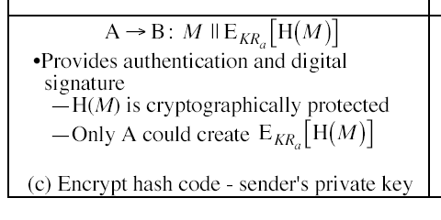

Slide 26
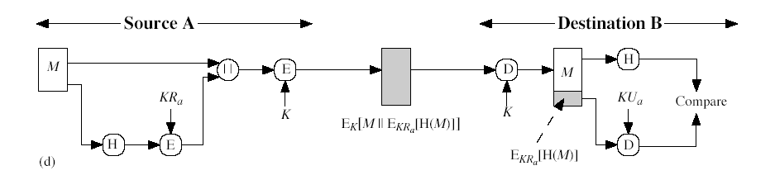
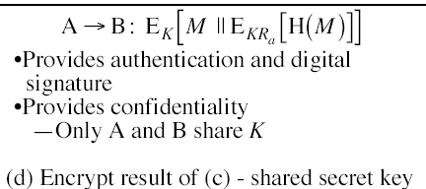

Slide 27
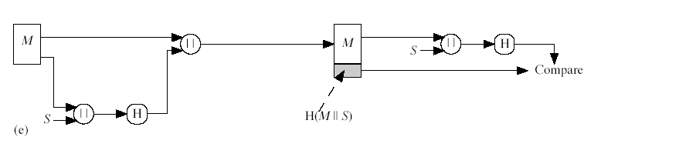
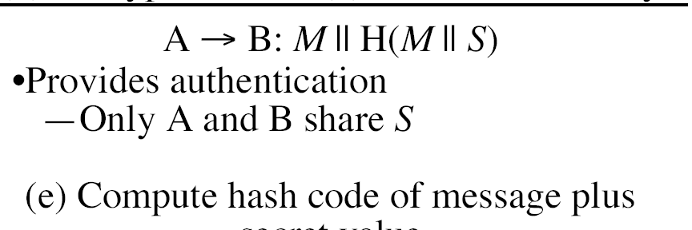

Slide 28
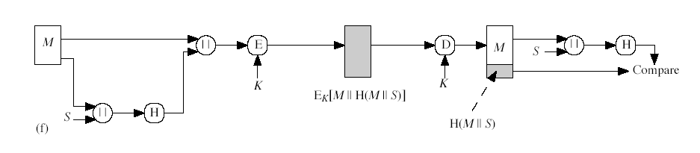
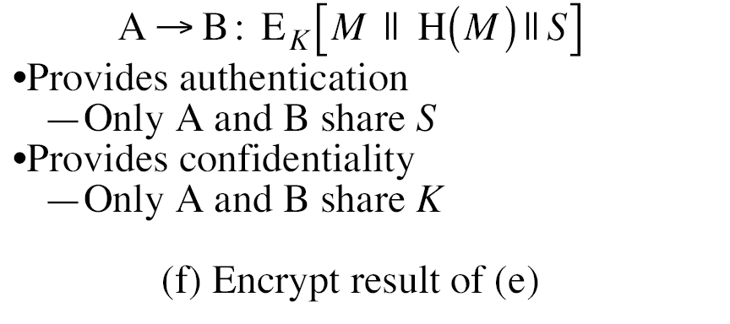

Slide 29
Requirements for Hash Functions
can be applied to any sized message M
produces fixed-length output h
is easy to compute h=H(M) for any message M
given h is infeasible to find x s.t. H(x)=h
  one-way property
given x is infeasible to find y s.t. H(y)=H(x)
  weak collision resistance
is infeasible to find any x,y s.t. H(y)=H(x)
  strong collision resistance
Notes:
These are the specifications for good hash functions. Essentially it must be extremely difficult to find 2 messages with the same hash, and the hash should not be related to the message in any obvious way (ie it should be a complex non-linear function of the message). There are quite a few similarities in the evolution of hash functions & block ciphers, and in the evolution of the design requirements on both.

Slide 30
Simple Hash Functions
are several proposals for simple functions
based on XOR of message blocks
not secure since can manipulate any message and either not change hash or change hash also
need a stronger cryptographic function (next chapter)

Slide 31
Birthday Attacks
might think a 64-bit hash is secure
but by Birthday Paradox is not
birthday attack works thus:
  opponent generates 2^{m/2} variations of a valid message all with essentially the same meaning
  opponent also generates 2^{m/2} variations of a desired fraudulent message
  two sets of messages are compared to find pair with same hash (probability > 0.5 by birthday paradox)
  have user sign the valid message, then substitute the forgery which will have a valid signature
conclusion is that need to use larger MACs
Notes:
The Birthday Attack exploits the birthday paradox – the chance that in a group of people two will share the same birthday – only 23 people are needed for a Pr>0.5 of this. Can generalize the problem to one wanting a matching pair from any two sets, and show need 2^{m/2} in each to get a matching m-bit hash.
Note that creating many message variants is relatively easy, either by rewording or just varying the amount of white-space in the message.

Slide 32
Block Ciphers as Hash Functions
can use block ciphers as hash functions
  using H₀=0 and zero-pad of final block
  compute: H_{i} = E_{Mi} [H_{i-1}]
  and use final block as the hash value
  similar to CBC but without a key
resulting hash is too small (64-bit)
  both due to direct birthday attack
  and to “meet-in-the-middle” attack
other variants also susceptible to attack

Slide 33
Hash Functions & MAC Security
like block ciphers have:
brute-force attacks exploiting
  strong collision resistance hash have cost 2^{m/2}
    have proposal for h/w MD5 cracker
    128-bit hash looks vulnerable, 160-bits better
  MACs with known message-MAC pairs
    can either attack keyspace (cf key search) or MAC
    at least 128-bit MAC is needed for security

Slide 34
Hash Functions & MAC Security
cryptanalytic attacks exploit structure
  like block ciphers want brute-force attacks to be the best alternative
have a number of analytic attacks on iterated hash functions
  CV_{i} = f[CV_{i-1}, M_{i}]; H(M)=CV_{N}
  typically focus on collisions in function f
  like block ciphers is often composed of rounds
  attacks exploit properties of round functions

